Slide 1
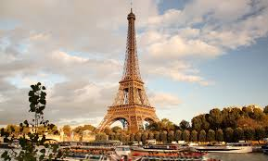
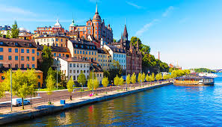
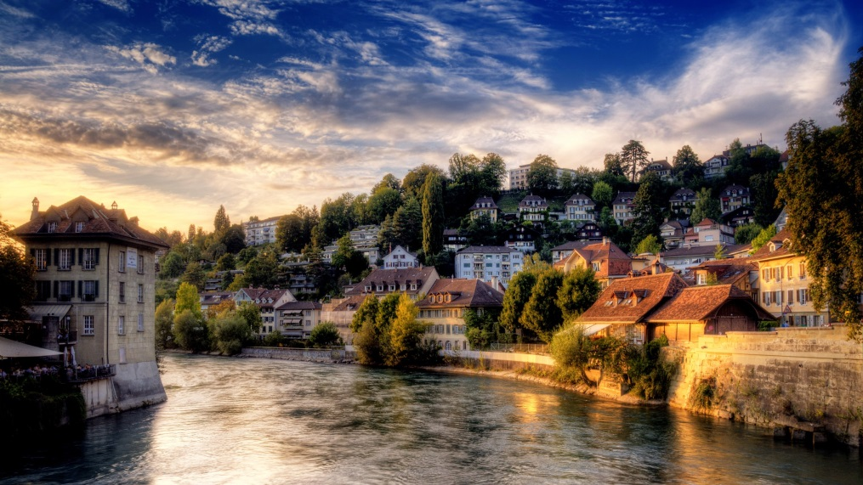
Features of European Cities
Strategies used in European Cities to enhance liveability

Slide 2
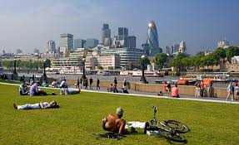
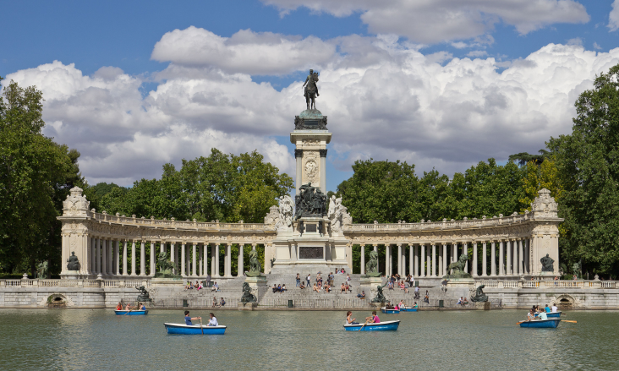

Features of European cities
1. Compact in size – they are smaller in area than places of similar population in Australia
2. Greater percentage of people living in medium density apartments.
3. Public places (parks, gardens, piazzas and green roofs).
4. Pedestrian only or shared streets
5. Well developed public transport systems
Use of smaller motor vehicles and smart cars
7. Support for local agriculture and farmers markets

Slide 3
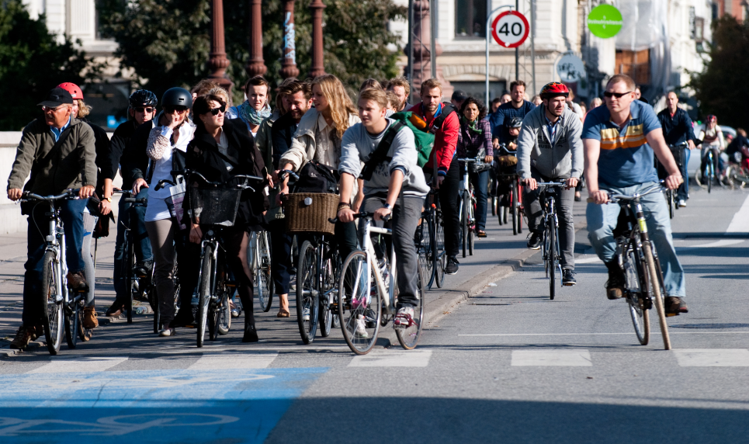
Copenhagen, Denmark
Has over 4000 km of cycling tracks, and cyclists make up about 35% of daily commuters.
Green bike routes improve access to recreational facilities
‘Pocket parks’ will give 90% of residents walkable access to a green space by 2050.

Slide 4
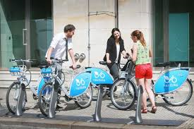
German city of Leipzig
In the German city of Leipzig, a simple 'bike sharing' system is helping to reduce congestion and to make the city more liveable.

Slide 5
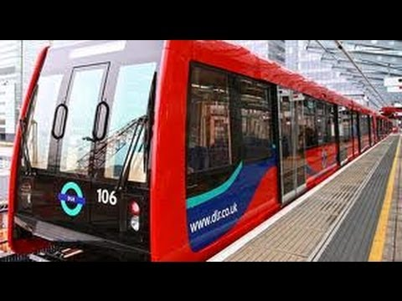
Light rail in london
In London they have a Docklands Light Rail (DLR) system.
This was set up to reduce congestion in a city with a population of approximately 8 million.
DLR's fully automated and driverless vehicles provide 300,000 journeys between the redeveloped Docklands area and central London each day, easing congestion on surrounding roads.

Slide 6
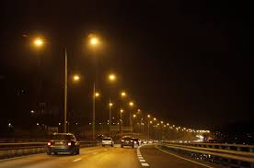
Oslo, Norway
In Oslo they use intelligent lighting that adjusts its intensity to suit traffic and weather conditions.
Car and bike sharing programs are in place along with 400 charging stations for an increasing number of electric vehicles.

Slide 7
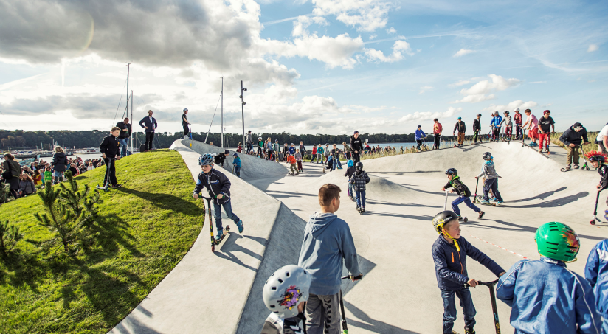

Improving liveability for young people
A skate park
A new indoors sports facility
A swimming pool
An cinema complex
An outdoor cinema
Better public transport
More shops and cafes
Cycle paths
Green open spaces
Outdoor area for music concerts

